Slide 1


FoSTERing Restoration Success at Cuyahoga Valley National Park
Christie Bahlai (Biological Sciences)
Chris Blackwood (Biological Sciences)
Anne Jefferson (Geology)
Notes:
Acknowledge funding sources: Kent State Department of Geology; Kent State Graduate Student Senate; the Geological Society of America; and the Geoscientists-in-the-Parks Program

Slide 2
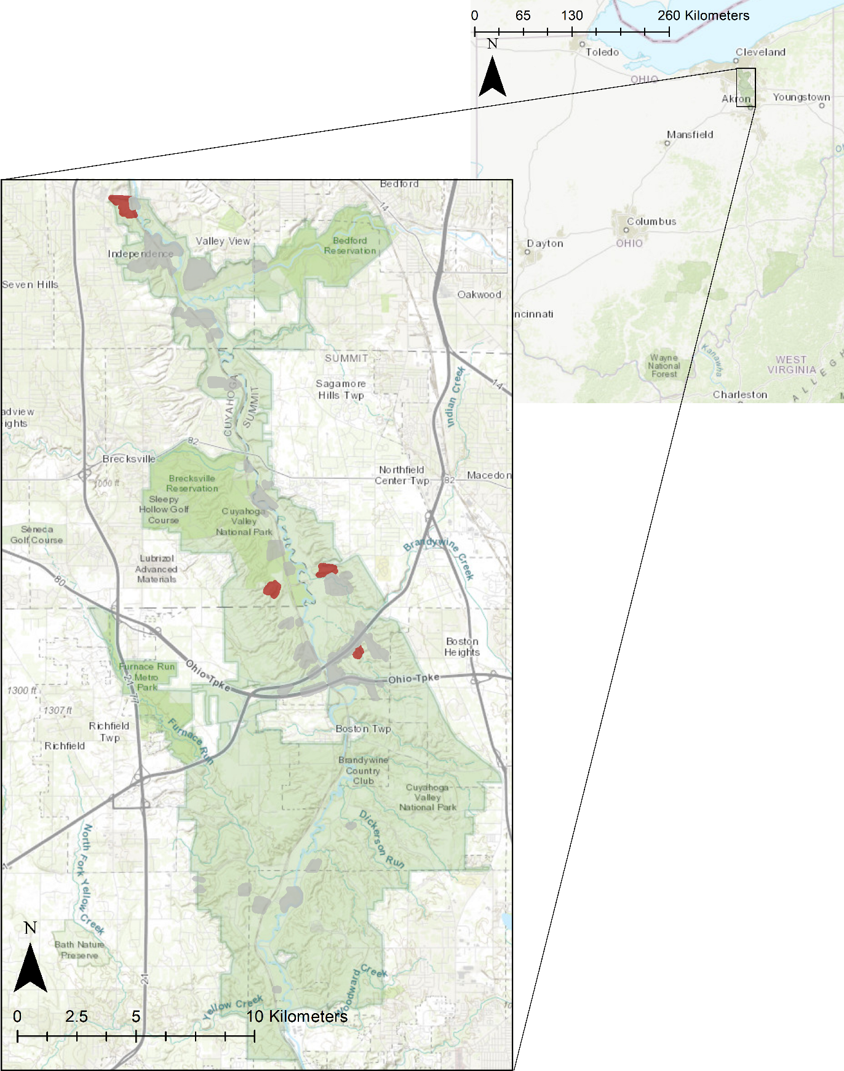
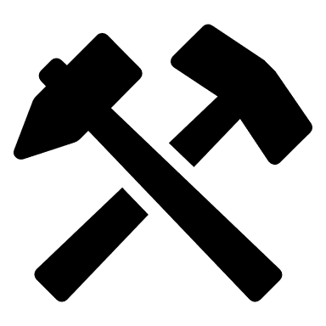
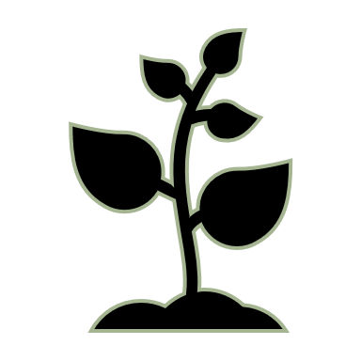


FoSTERing Reforestation
Cuyahoga Valley used for farming, industry, & mining
Cuyahoga Valley National Park established in 2000
Park Goal: reforest mine sites
Kent State is science partner
Notes:
CUVA decided to put this reclamation plan into action in 2016, starting with a topsoil mine known as Dover.
During the 1990s, the top 3 m of topsoil were removed from Dover for construction of a ski slope. Shortly afterward, the mine was reclaimed in accordance with SMACK-RA. It was backfilled with dredged sediment and leftover soils from a parking lot construction.
In 2012, in an attempt to return Dover to a native forestland, CUVA planted approximately 1200 native tree seedlings. By 2016 over 95% of the seedlings had died. Inspection of the seedlings led CUVA staff to believe that root constriction was the cause.
While Dover is the only site that CUVA has attempted to plant without further reclamation, it is one of five sites that are currently slated for reforestation.
We have started studying the soil properties on the sites that were reclaimed under SMACK-RA guidelines and how those properties change with deep-ripping.

Slide 3
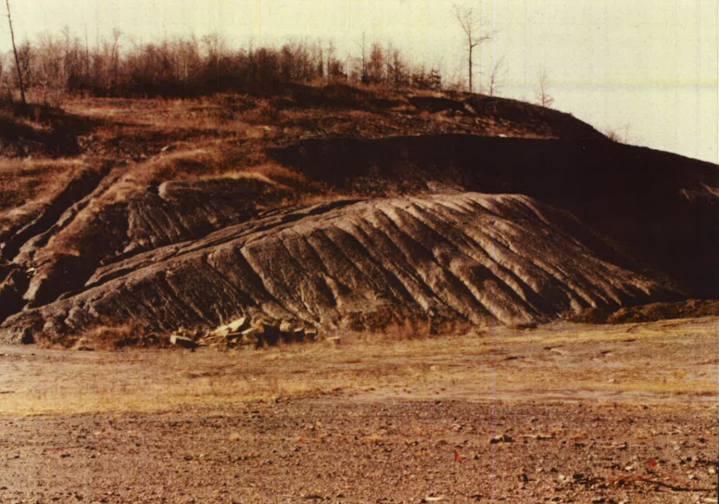
Snowville Quarry
1950s – 1990s
Slope cut backwards as
sand and gravel was quarried
Photo: CUVA Division of Resource Management
Notes:
CUVA decided to put this reclamation plan into action in 2016, starting with a topsoil mine known as Dover.
During the 1990s, the top 3 m of topsoil were removed from Dover for construction of a ski slope. Shortly afterward, the mine was reclaimed in accordance with SMACK-RA. It was backfilled with dredged sediment and leftover soils from a parking lot construction.
In 2012, in an attempt to return Dover to a native forestland, CUVA planted approximately 1200 native tree seedlings. By 2016 over 95% of the seedlings had died. Inspection of the seedlings led CUVA staff to believe that root constriction was the cause.
While Dover is the only site that CUVA has attempted to plant without further reclamation, it is one of five sites that are currently slated for reforestation.
We have started studying the soil properties on the sites that were reclaimed under SMACK-RA guidelines and how those properties change with deep-ripping.

Slide 4
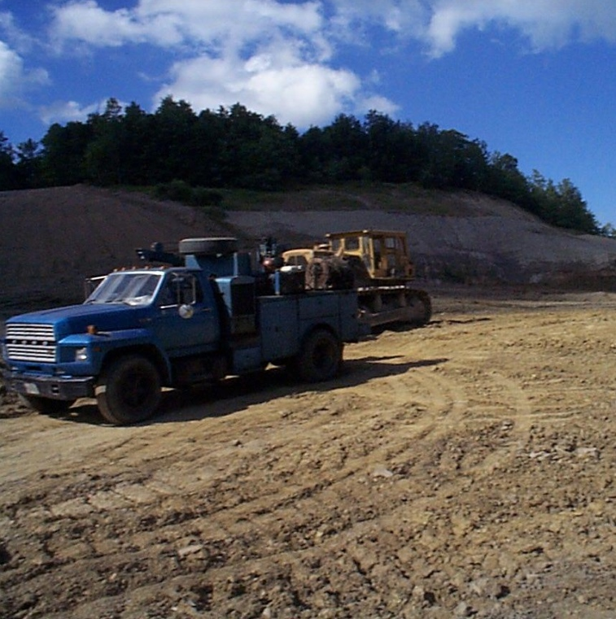
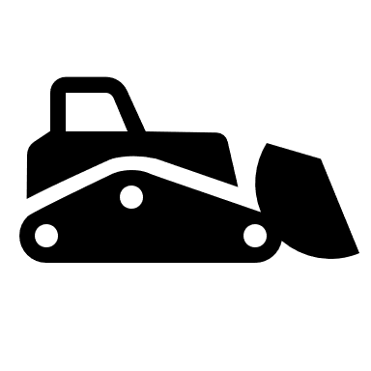
Snowville Quarry
1950s – 1990s
Slope cut backwards as
sand and gravel was quarried
1999
Site is graded, compacted
and seeded
Photo: CUVA Division of Resource Management
Notes:
CUVA decided to put this reclamation plan into action in 2016, starting with a topsoil mine known as Dover.
During the 1990s, the top 3 m of topsoil were removed from Dover for construction of a ski slope. Shortly afterward, the mine was reclaimed in accordance with SMACK-RA. It was backfilled with dredged sediment and leftover soils from a parking lot construction.
In 2012, in an attempt to return Dover to a native forestland, CUVA planted approximately 1200 native tree seedlings. By 2016 over 95% of the seedlings had died. Inspection of the seedlings led CUVA staff to believe that root constriction was the cause.
While Dover is the only site that CUVA has attempted to plant without further reclamation, it is one of five sites that are currently slated for reforestation.
We have started studying the soil properties on the sites that were reclaimed under SMACK-RA guidelines and how those properties change with deep-ripping.

Slide 5
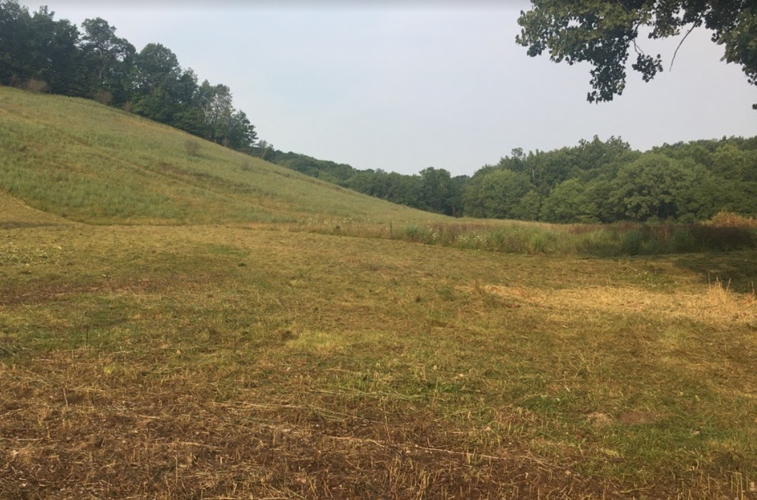
Snowville Quarry
1950s – 1990s
Slope cut backwards as
sand and gravel was quarried
1999
Site is graded, compacted
and seeded
2001
Planted 1125 tree seedlings. They all died.
Notes:
CUVA decided to put this reclamation plan into action in 2016, starting with a topsoil mine known as Dover.
During the 1990s, the top 3 m of topsoil were removed from Dover for construction of a ski slope. Shortly afterward, the mine was reclaimed in accordance with SMACK-RA. It was backfilled with dredged sediment and leftover soils from a parking lot construction.
In 2012, in an attempt to return Dover to a native forestland, CUVA planted approximately 1200 native tree seedlings. By 2016 over 95% of the seedlings had died. Inspection of the seedlings led CUVA staff to believe that root constriction was the cause.
While Dover is the only site that CUVA has attempted to plant without further reclamation, it is one of five sites that are currently slated for reforestation.
We have started studying the soil properties on the sites that were reclaimed under SMACK-RA guidelines and how those properties change with deep-ripping.

Slide 6
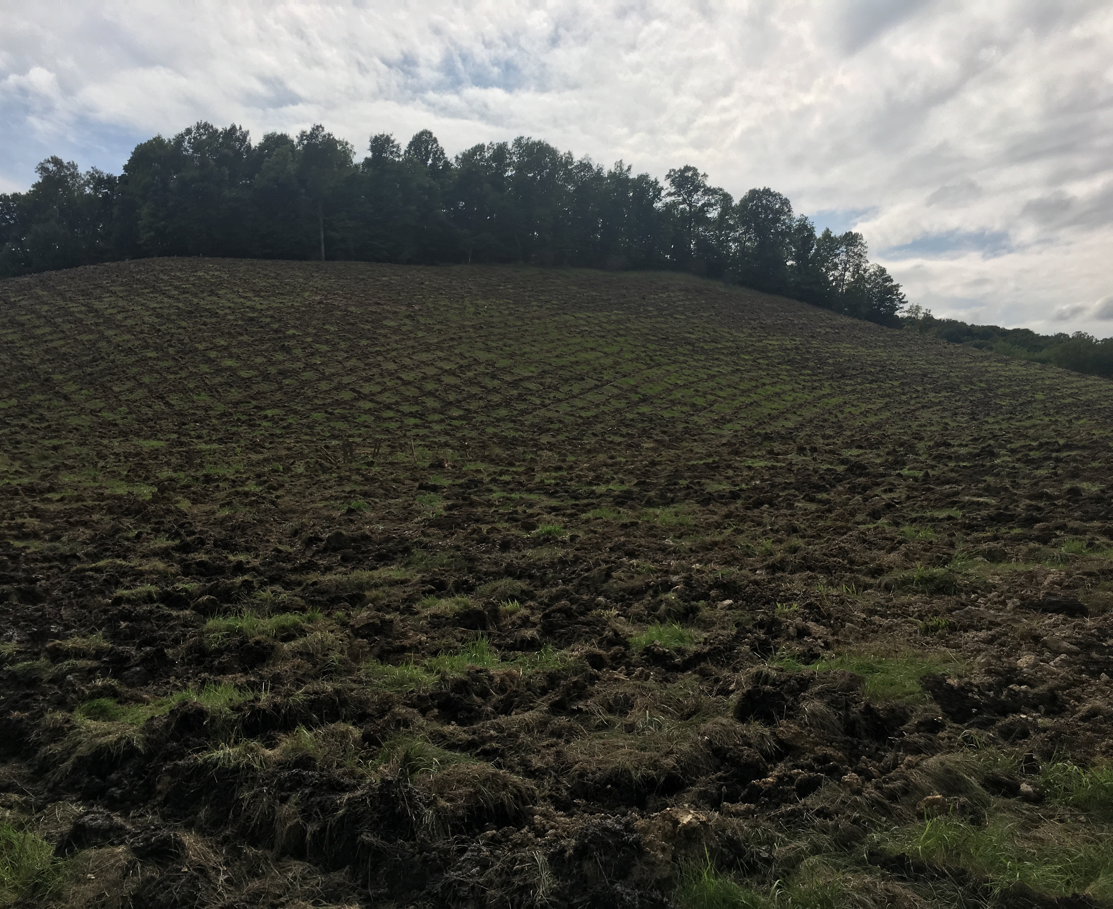
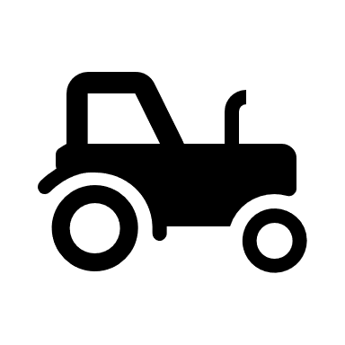
Snowville Quarry
1950s – 1990s
Slope cut backwards as
sand and gravel was quarried
1999
Site is graded, compacted
and seeded
2001
Planted 1125 tree seedlings. They all died.
September 2018
Site is deep-ripped
Notes:
CUVA decided to put this reclamation plan into action in 2016, starting with a topsoil mine known as Dover.
During the 1990s, the top 3 m of topsoil were removed from Dover for construction of a ski slope. Shortly afterward, the mine was reclaimed in accordance with SMACK-RA. It was backfilled with dredged sediment and leftover soils from a parking lot construction.
In 2012, in an attempt to return Dover to a native forestland, CUVA planted approximately 1200 native tree seedlings. By 2016 over 95% of the seedlings had died. Inspection of the seedlings led CUVA staff to believe that root constriction was the cause.
While Dover is the only site that CUVA has attempted to plant without further reclamation, it is one of five sites that are currently slated for reforestation.
We have started studying the soil properties on the sites that were reclaimed under SMACK-RA guidelines and how those properties change with deep-ripping.

Slide 7
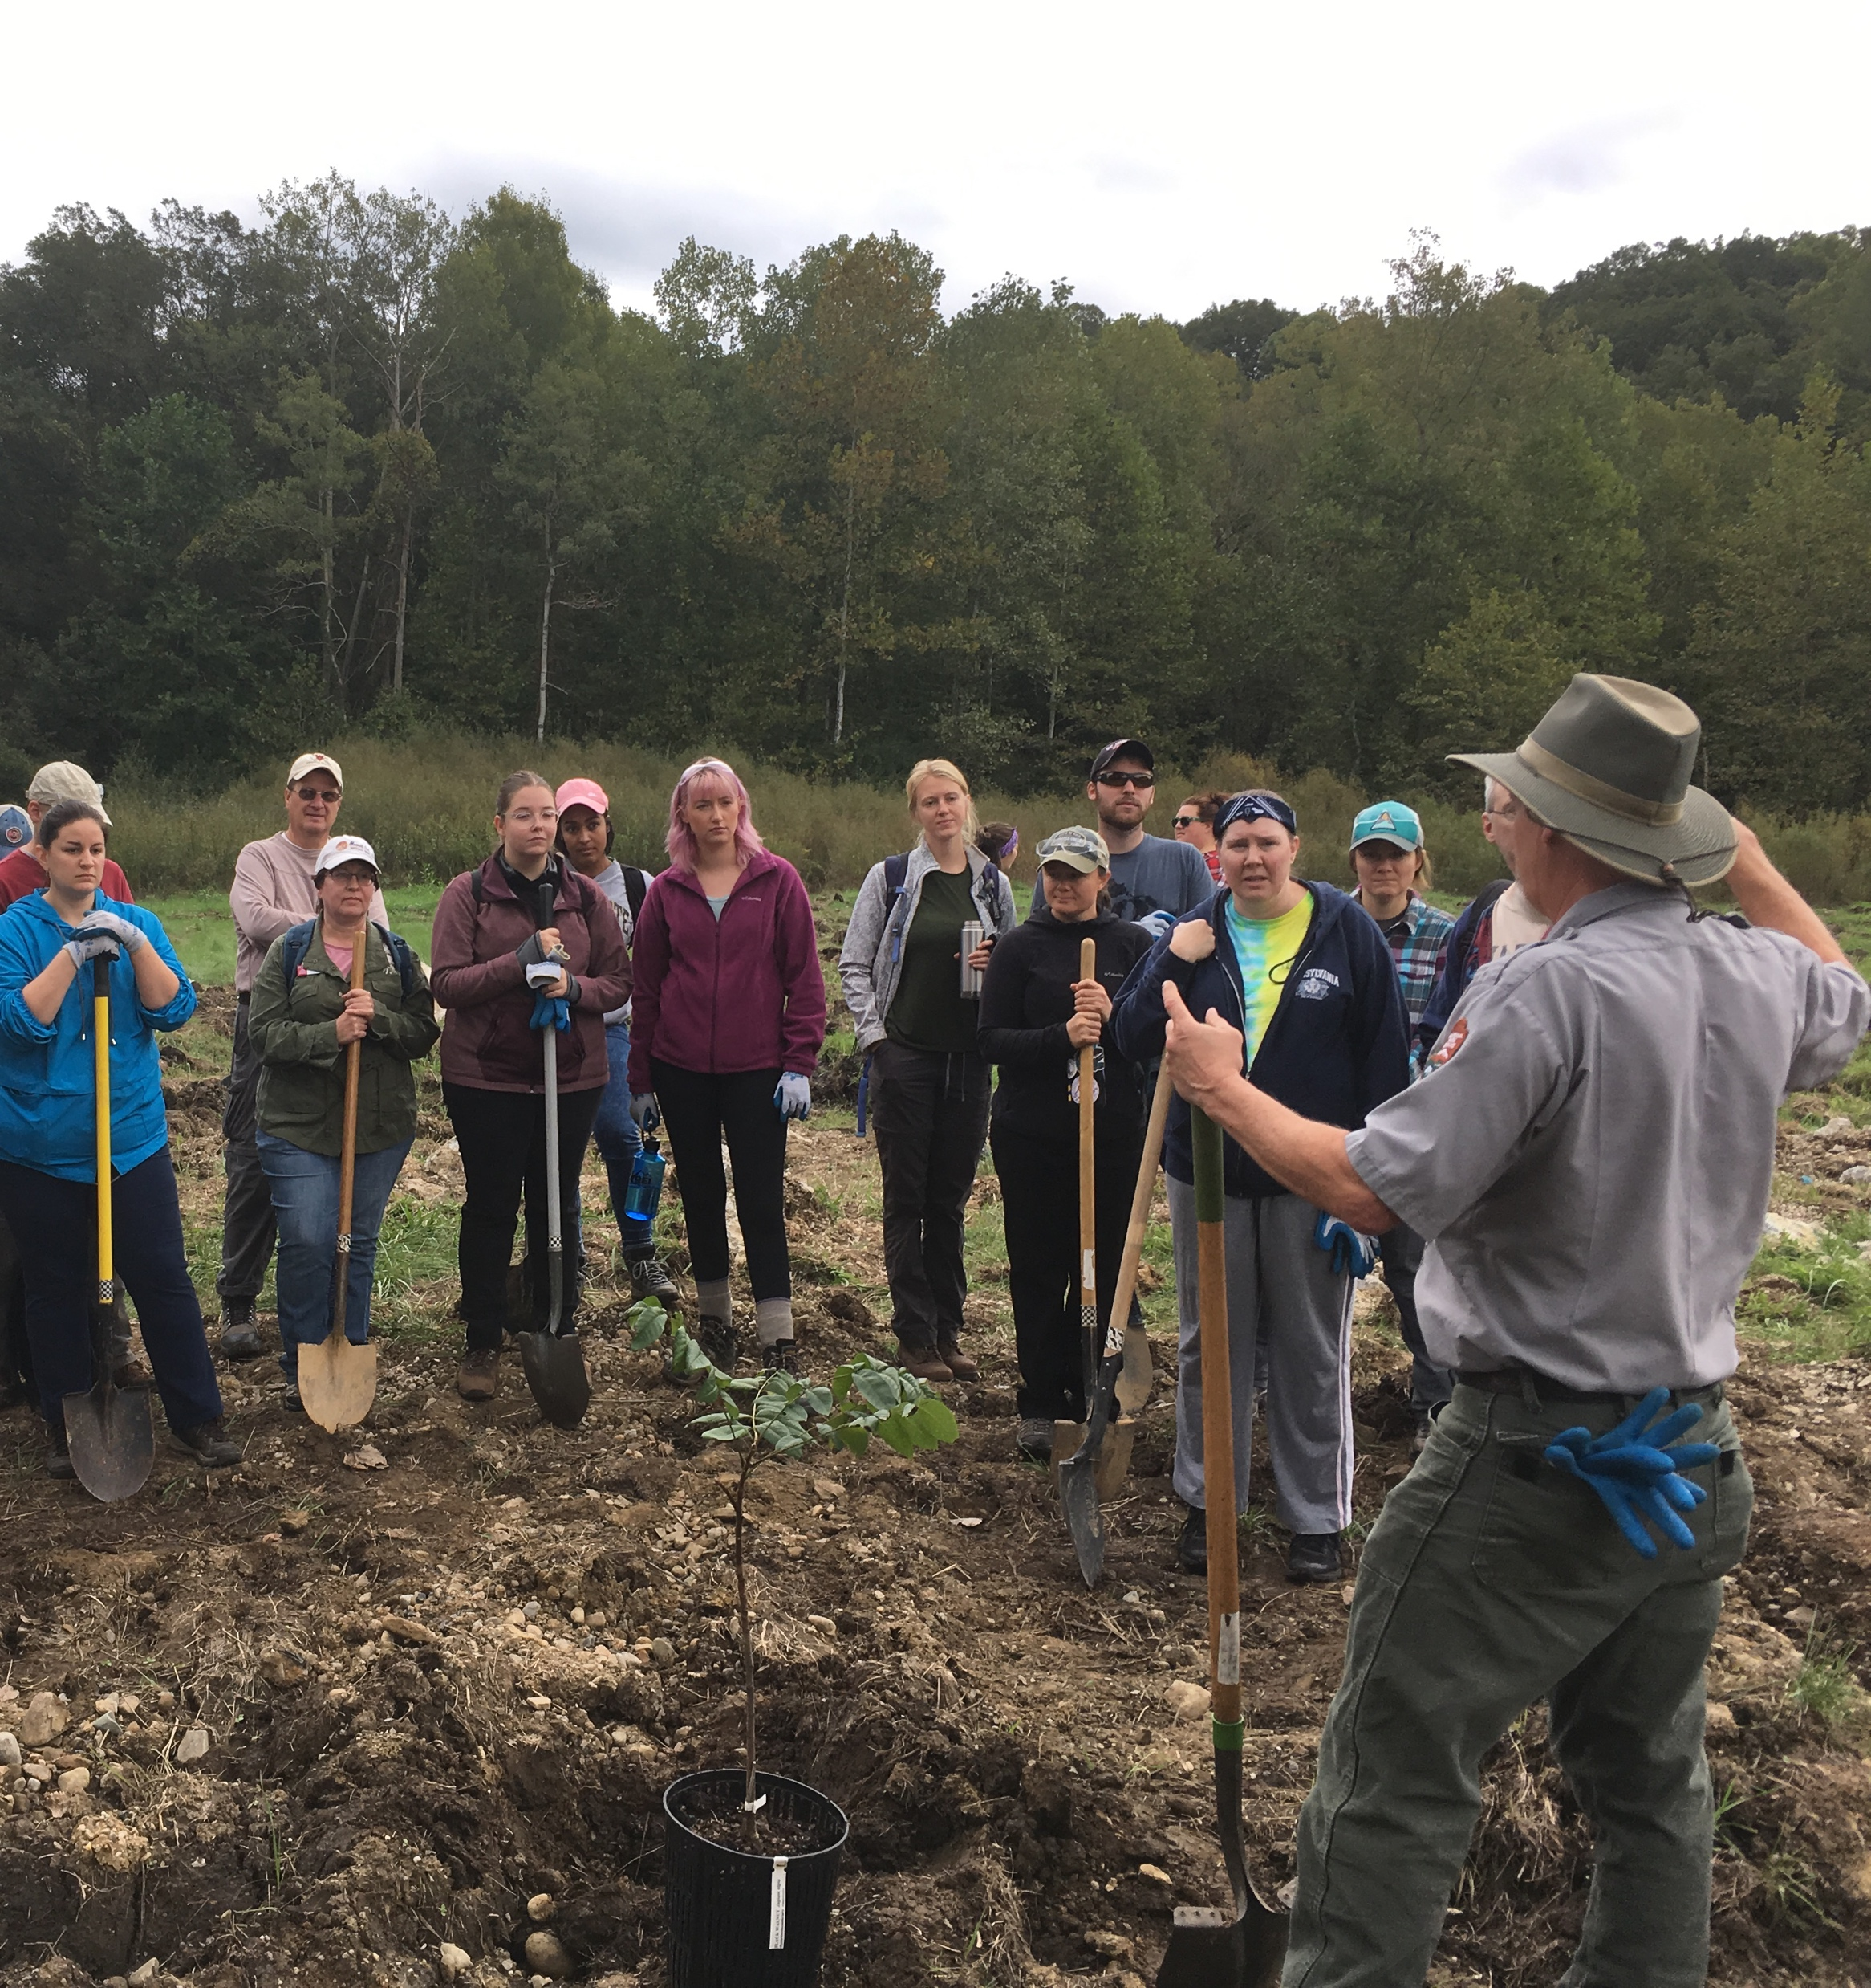
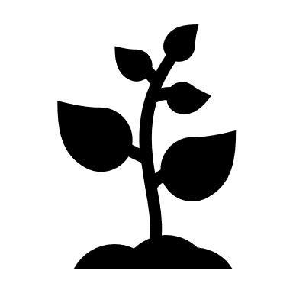
Snowville Quarry
1950s – 1990s
Slope cut backwards as
sand and gravel was quarried
1999
Site is graded, compacted
and seeded
2001
Planted 1125 tree seedlings. They all died.
September 2018
Site is deep-ripped
September 2018 – Current
Native tree saplings are being
planted in the cross-rips
Notes:
CUVA decided to put this reclamation plan into action in 2016, starting with a topsoil mine known as Dover.
During the 1990s, the top 3 m of topsoil were removed from Dover for construction of a ski slope. Shortly afterward, the mine was reclaimed in accordance with SMACK-RA. It was backfilled with dredged sediment and leftover soils from a parking lot construction.
In 2012, in an attempt to return Dover to a native forestland, CUVA planted approximately 1200 native tree seedlings. By 2016 over 95% of the seedlings had died. Inspection of the seedlings led CUVA staff to believe that root constriction was the cause.
While Dover is the only site that CUVA has attempted to plant without further reclamation, it is one of five sites that are currently slated for reforestation.
We have started studying the soil properties on the sites that were reclaimed under SMACK-RA guidelines and how those properties change with deep-ripping.

Slide 8
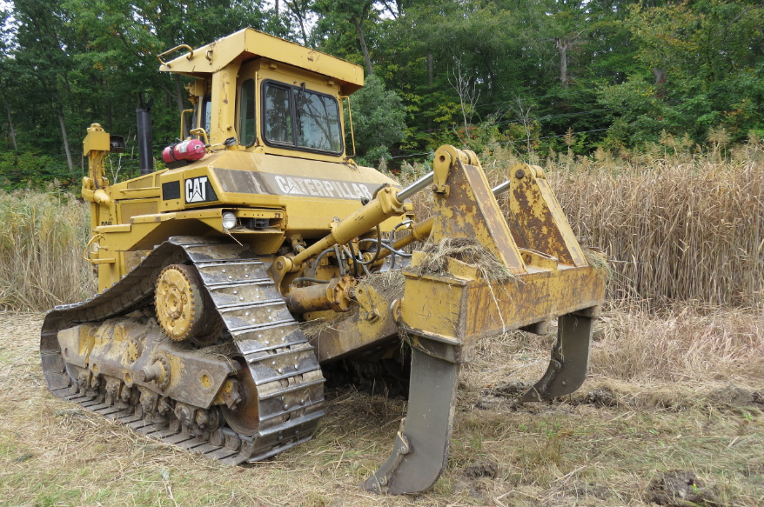
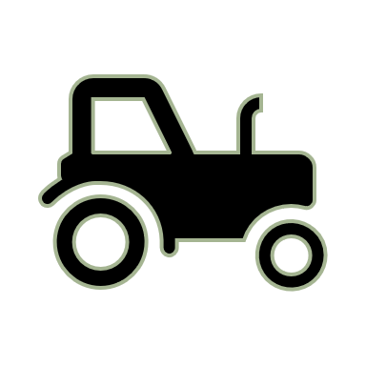

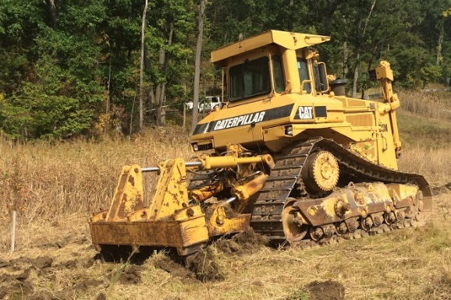
Deep-Ripping Reclamation
A bulldozer with plow-shaped shanks
rips the site in a cross-hatch pattern
Tilling the soil reduces soil compaction
Reduced soil compaction and rough
microtopography increases water
infiltration and rooting
Notes:
One approach in reclaiming these surface mines is a process referred to as “deep-ripping,” “deep-tillage,” or “subsoiling.”
After invasive plants are removed from a site (often through a combination of herbicide application and mowing), a bulldozer with meter-long shanks will make passes over a surface mine to rip up the soil in a fashion similar to tilling. In clay-rich environments, a plow-shaped shank is used and the bulldozer rips in a cross-hatch pattern to better rupture the surface of the soil and prevent trenching during precipitation events.
This process of deep-ripping is meant to reduce soil compaction and ultimately promote infiltration and rooting. Trees can then be planted at the intersection of these rips, where the roots can branch out in four directions to take advantage of the reduced soil compaction, increased infiltration, and reduced invasive plant competition.

Slide 9
Science Questions, Part 1: What’s wrong?
How do the mine sites differ from un-mined soils and ecosystems?
Catherine Ruhm, MS, 2018
On-going and completed data collection by Blackwood lab

Slide 11
Surface bulk density isn’t so much the problem as what happens below 5 cm.
Soils become too dense for roots.

Slide 13
Science Questions, Part 2: How does restoration change things?
How does deep-ripping affect soil properties, hydrology, and ecosystems?
Data on hydrology/soil physical properties for 1 site (Dover) in Ruhm MS thesis.
On-going soils/hydrology data collection at site 2 (Snowville). This is where you come in.
Biologists are doing stuff too.

Slide 15
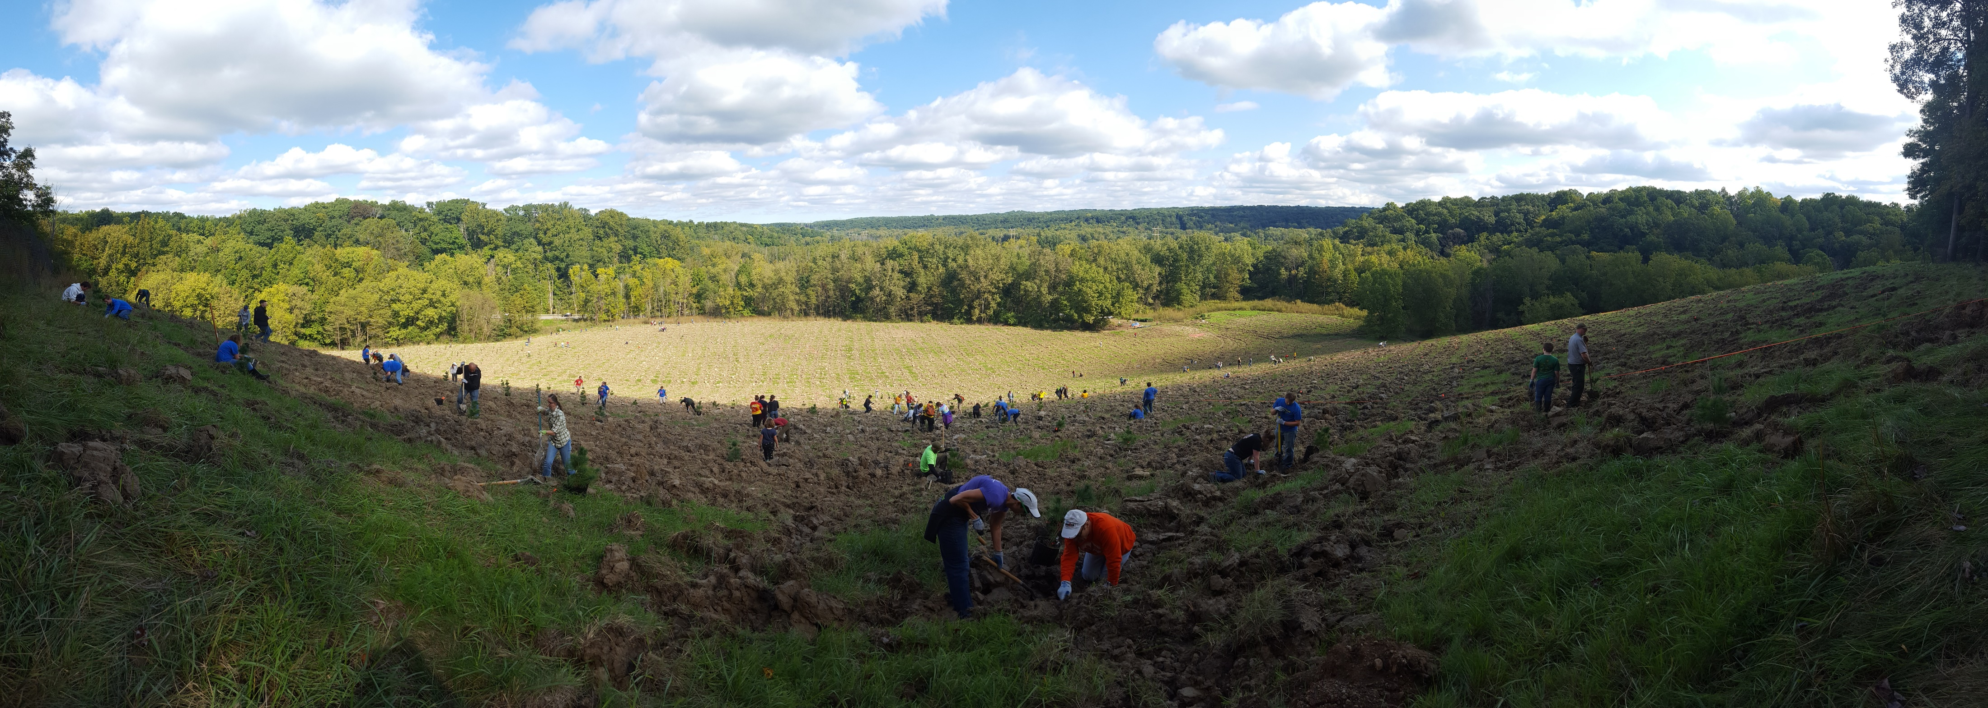
Science Questions, Part 3: What happens next?
How do different mycorrhizae and trees change the soil, hydrology, and ecosystem?
First we need to keep the trees alive!

Slide 16
Science Questions, Part 2: How does restoration change things?
How does deep-ripping affect soil properties, hydrology, and ecosystems?
Data on hydrology/soil physical properties for 1 site (Dover) in Ruhm MS thesis.
On-going soils/hydrology data collection at site 2 (Snowville). This is where you come in.
Biologists are doing stuff too.

Slide 17
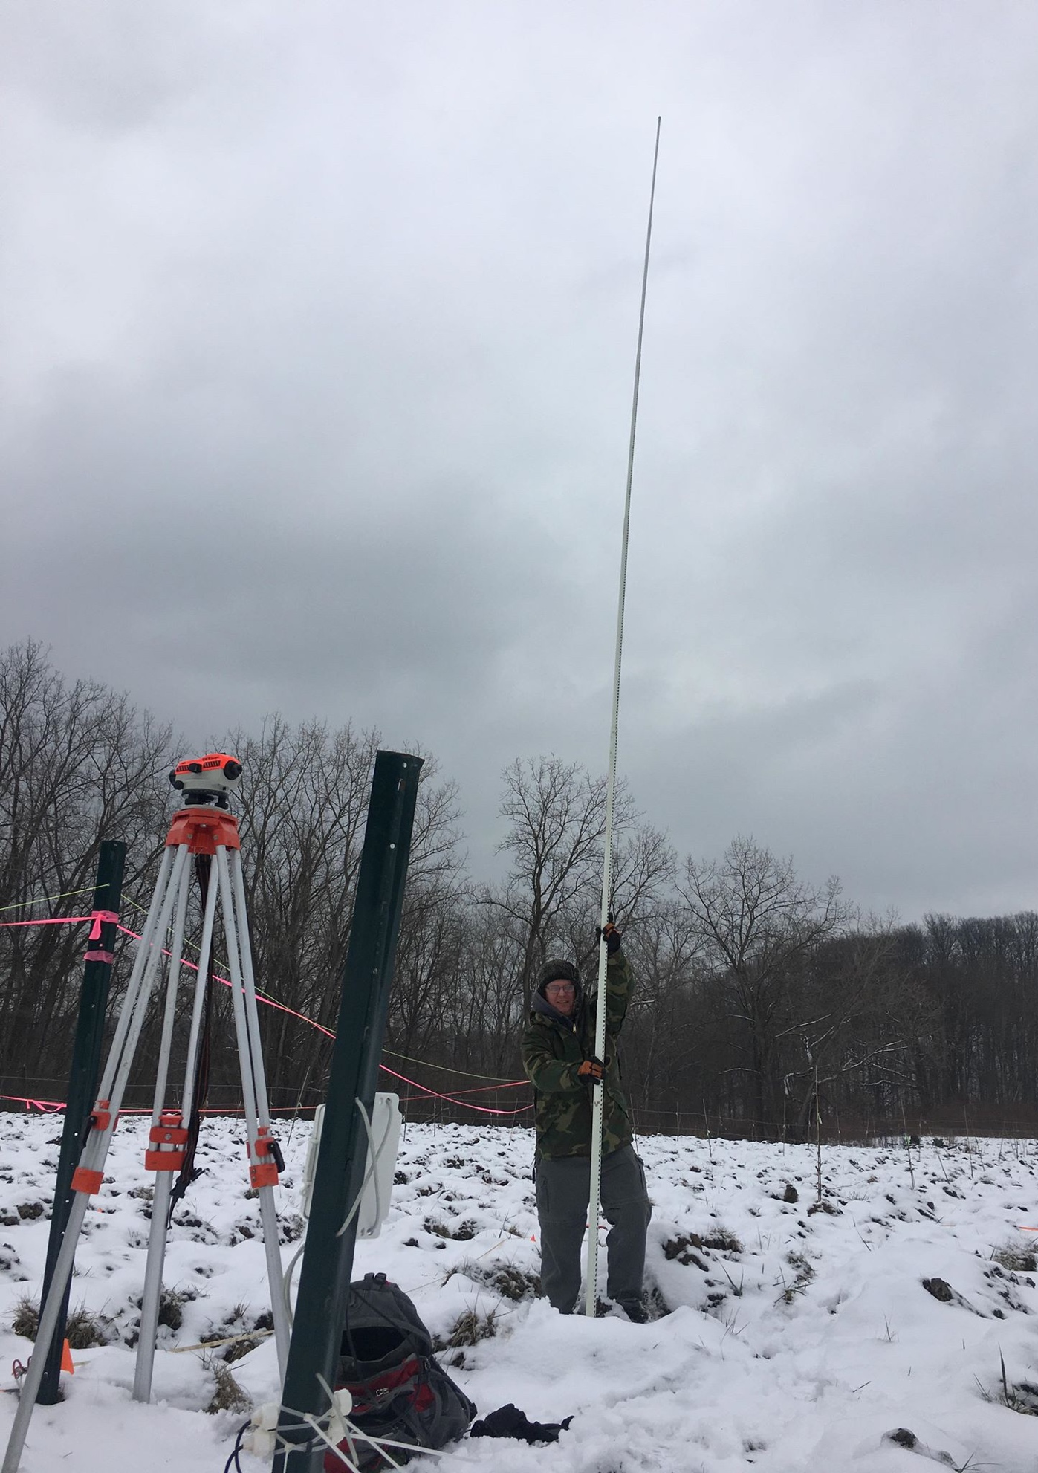
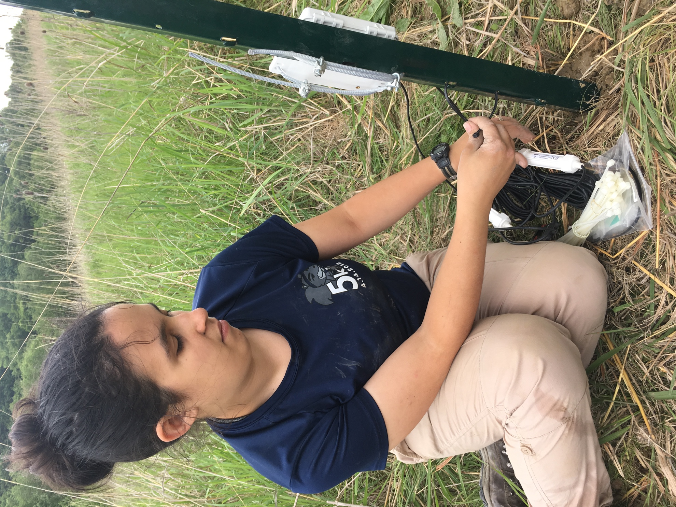
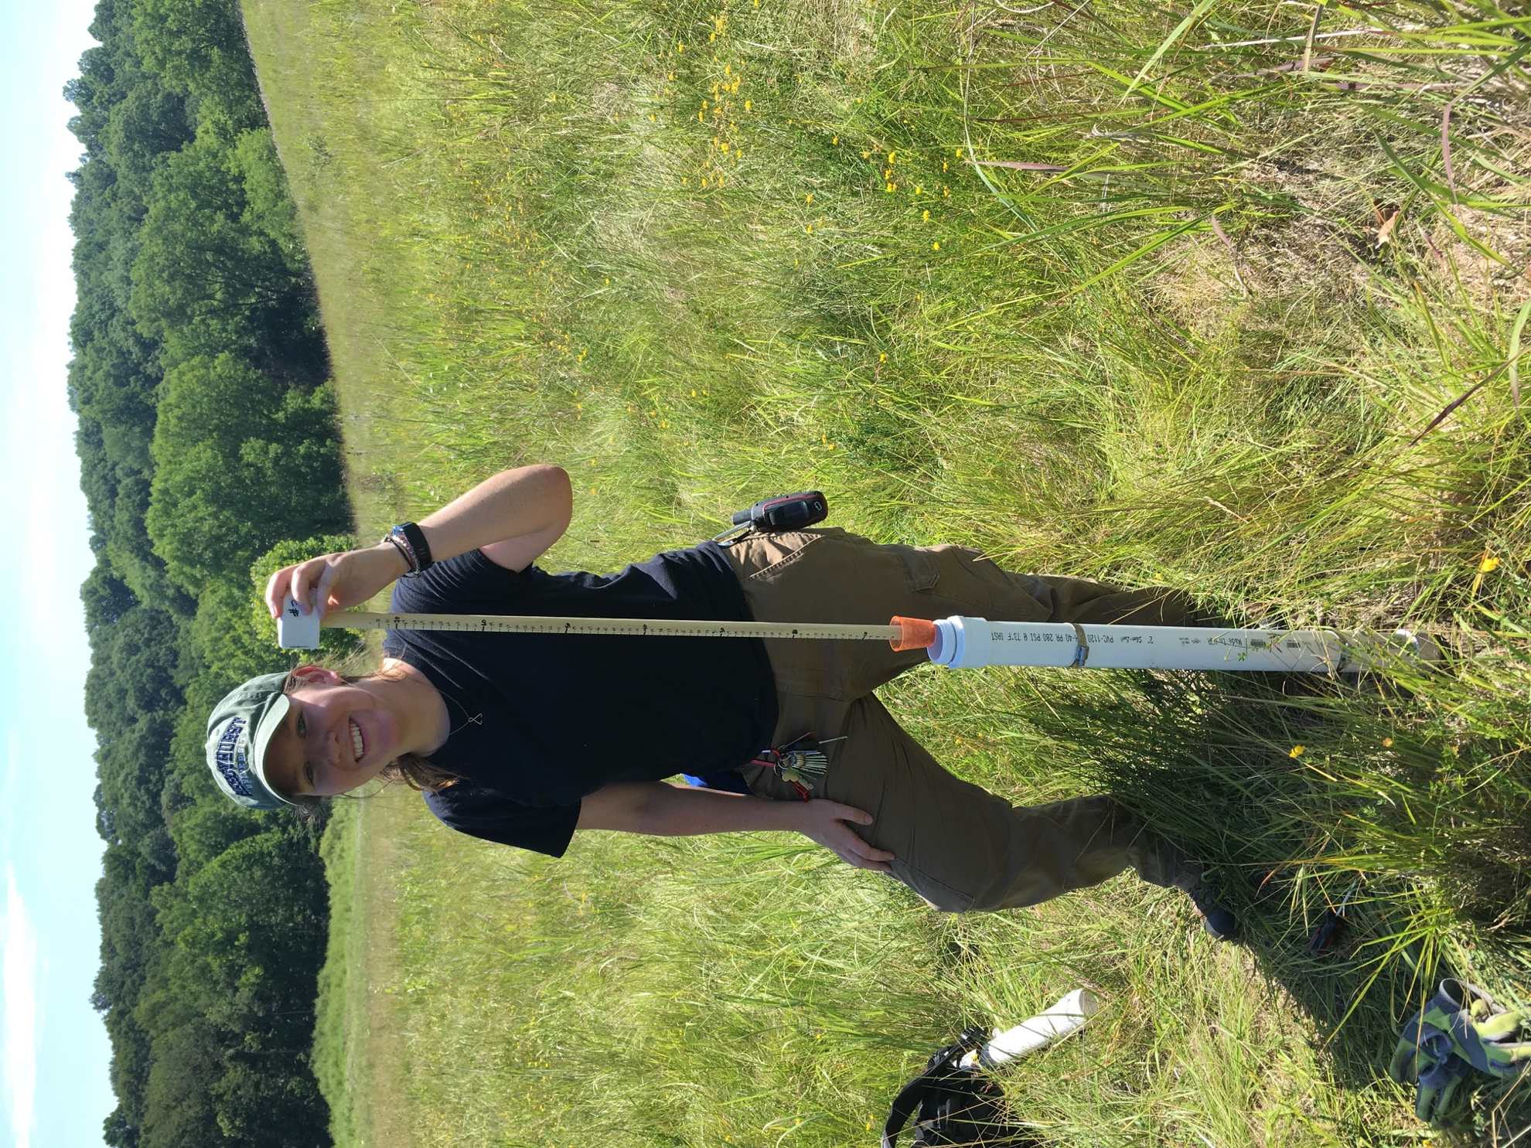
Soil moisture
Surface runoff
Topography

Slide 18
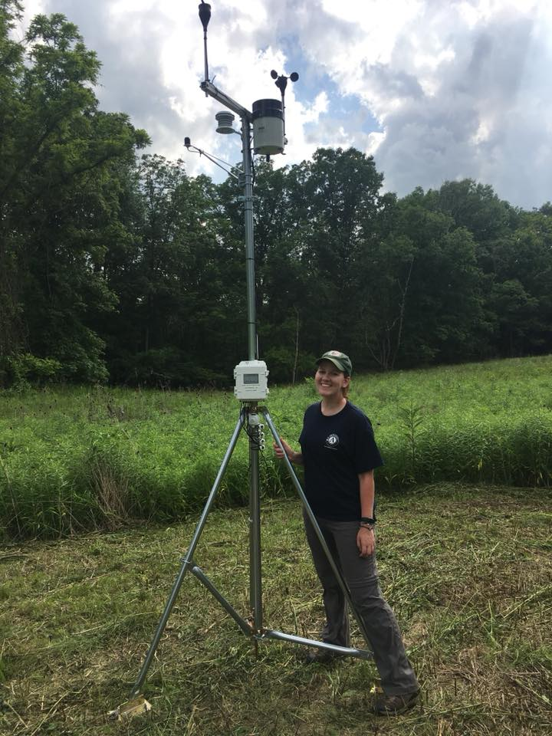
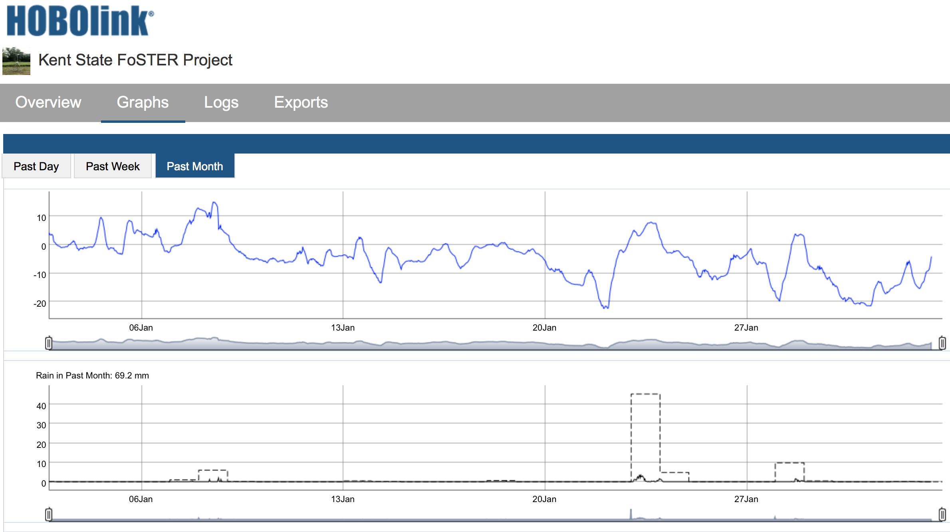
Weather Station
Adfadf
Temperature
Rain (mm)
https://hobolink.com/p/2a35b5e2fc23e20c9d7388c41a31f8fb

Slide 19
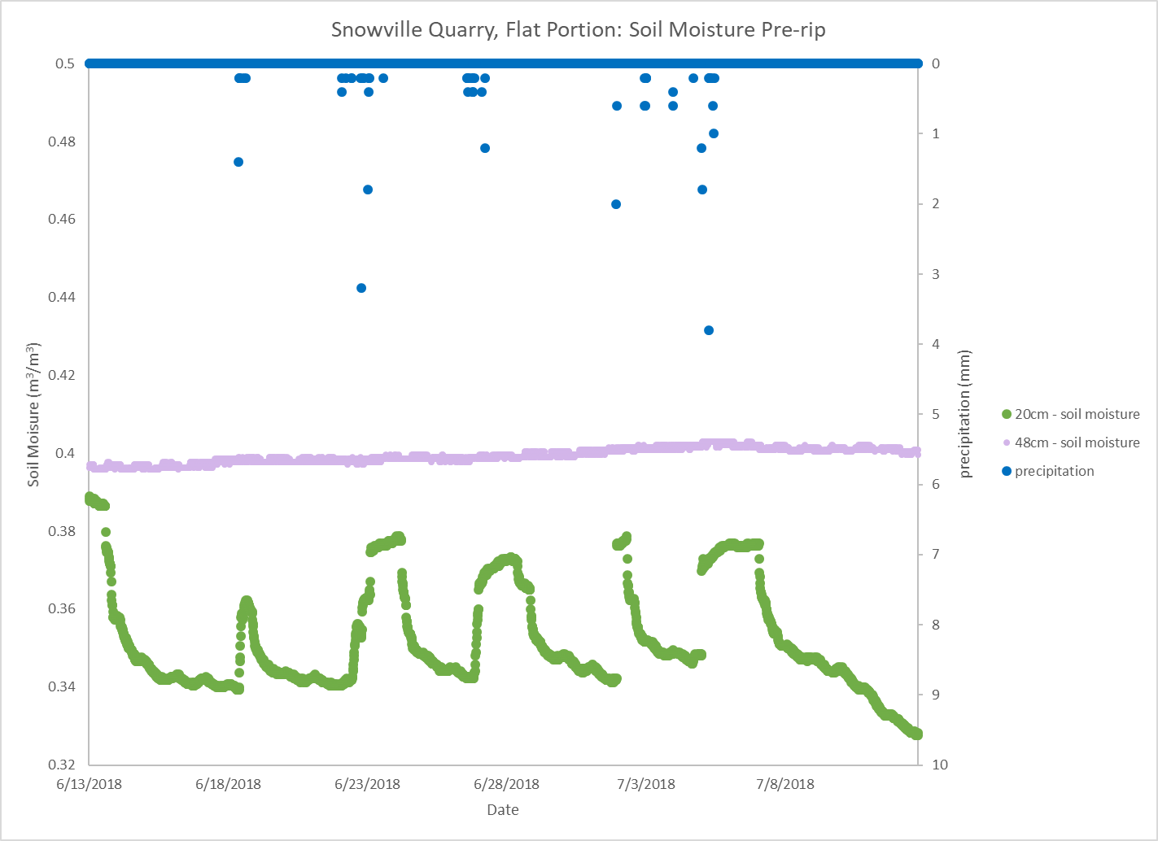
2 months pre-rip (2018) 1 year post-rip (Sept 2018-present)

Slide 20

How does ripping affect soil moisture?
Pre-rip vs. post-rip
Slope vs. flat portion of site
No-rip vs. single rip vs. cross-rip (intersection of rips)
Seasonal (but weather is different)
Response to precipitation inputs (using weather station data)
Slope

Slide 21
How does ripping affect soil moisture?
Pre-rip – slope
20 cm
50 cm
Pre-rip – flat
20 cm
50 cm
Slope
Flat

Slide 22
How does ripping affect soil moisture?
Post-rip – slope
10 cm cross-rip
10 cm EW rip (slope parallel)
10 cm NS rip (up-down slope)
Post-rip – flat
10 cm cross-rip
20 cm no rip
Slope
Flat

Slide 23
Supporting data (later in semester?)
Bulk density – top 5 cm (pre- and post-)
Bulk density profiles near soil moisture sites (pre- and post-)
Saturated hydraulic conductivity (pre- and post-)
Advanced topic: topographic change!

Slide 24
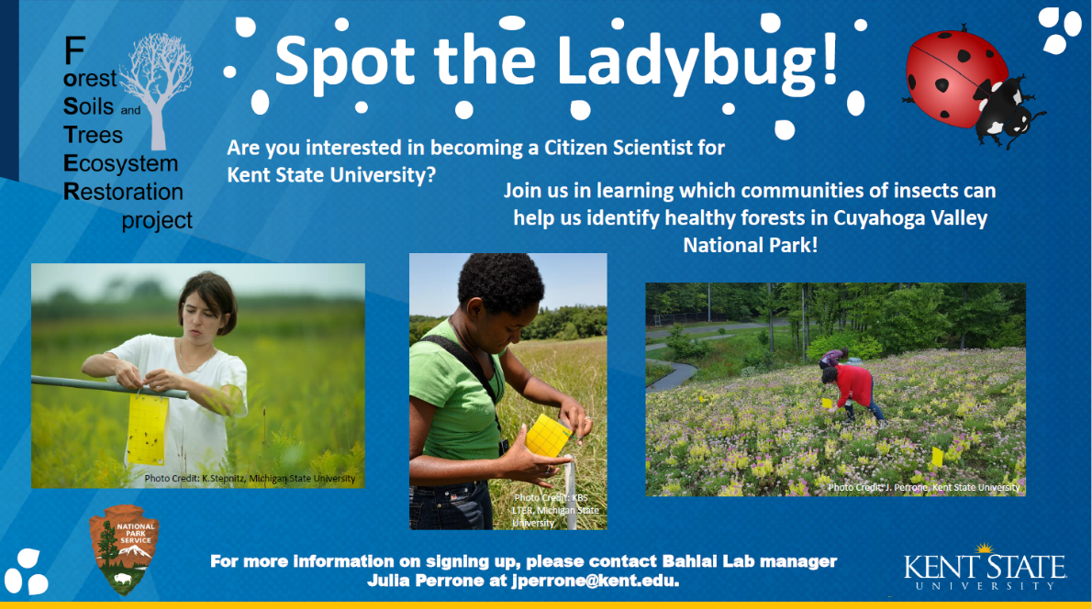
Participatory Science
Recruitment of volunteers at planting events

Slide 25
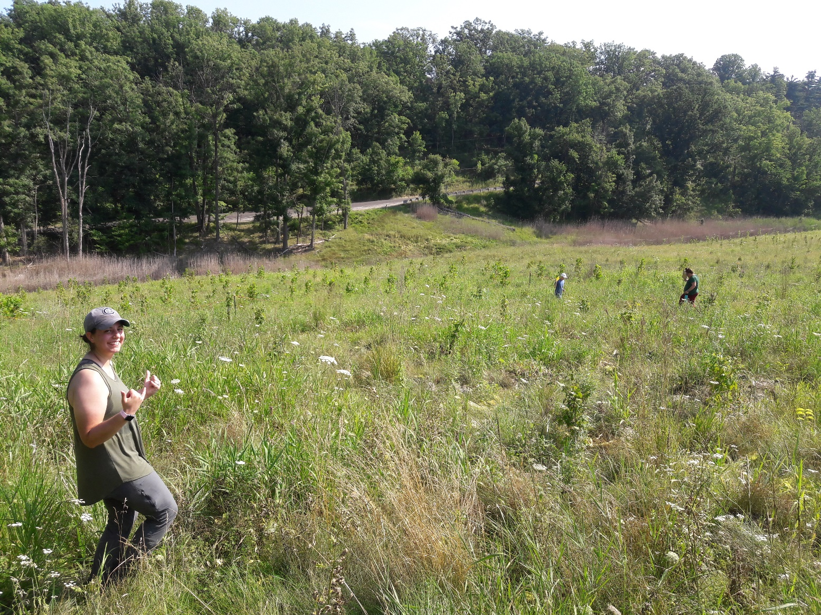
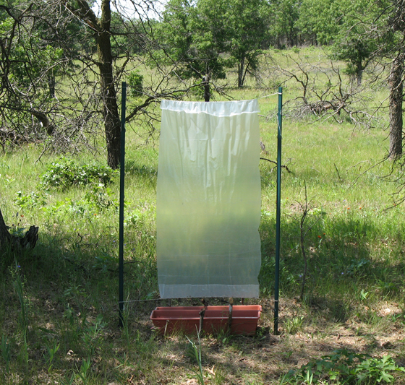
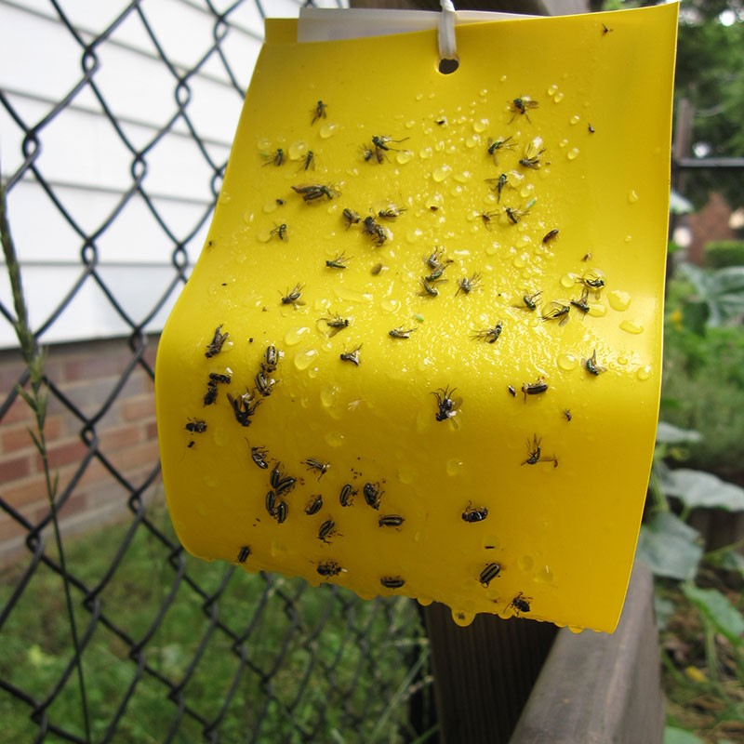
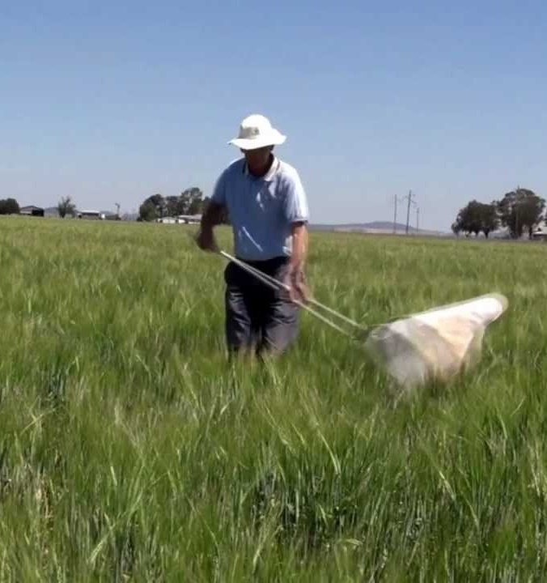
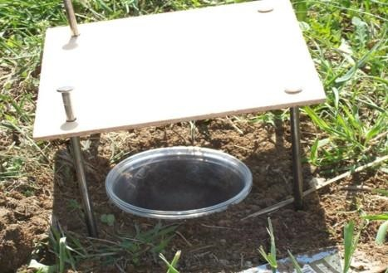
Participatory Science
Trial run of “Spot the Ladybug”
New event- The CVNP Beetle blitz!

Slide 26
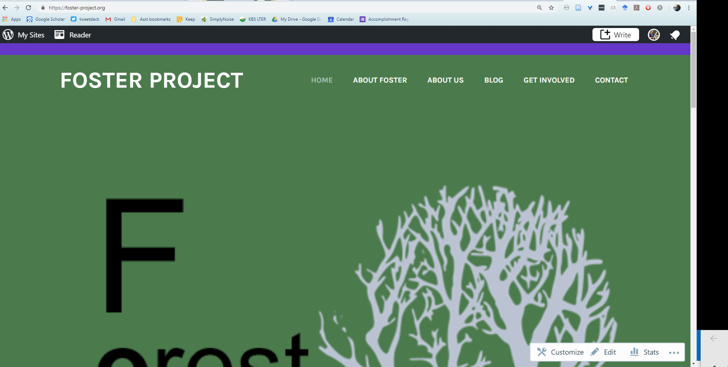


3. The website
https://foster-project.org
Beta testing Google forms/sheets as data entry system, but running into limits
Exploring alternative data management software suites

Slide 27
4. Education
Volunteers for participatory science recruited (summer, fall 2018 plantings)
Additional volunteers to be recruited (spring 2019 plantings)
Pre/post-test for volunteers, under development
Noticing skills (qualitative notes, details in environment)
Insect identification skills
Measuring skills (trees)
Training for volunteer trainers, under development

Slide 28
Future Funding Strategy
KSU student placed as Geoscientist-in-the-Park
Dominion Energy Foundation proposal, April 2018
NSF Research Coordination Network proposal, November 2018
Cooperative Ecosystem Studies Unit proposal, December 2018
NSF Macrosystems proposal in progress for February submission, “incidental tick capture.”
More submissions planned

Slide 29
Deep-Ripping Reclamation
A bulldozer with plow-shaped shanks
rips the site in a cross-hatch pattern
Tilling the soil reduces soil compaction
Reduced soil compaction and rough
microtopography increases water
infiltration and rooting
Notes:
One approach in reclaiming these surface mines is a process referred to as “deep-ripping,” “deep-tillage,” or “subsoiling.”
After invasive plants are removed from a site (often through a combination of herbicide application and mowing), a bulldozer with meter-long shanks will make passes over a surface mine to rip up the soil in a fashion similar to tilling. In clay-rich environments, a plow-shaped shank is used and the bulldozer rips in a cross-hatch pattern to better rupture the surface of the soil and prevent trenching during precipitation events.
This process of deep-ripping is meant to reduce soil compaction and ultimately promote infiltration and rooting. Trees can then be planted at the intersection of these rips, where the roots can branch out in four directions to take advantage of the reduced soil compaction, increased infiltration, and reduced invasive plant competition.

